Slide 1
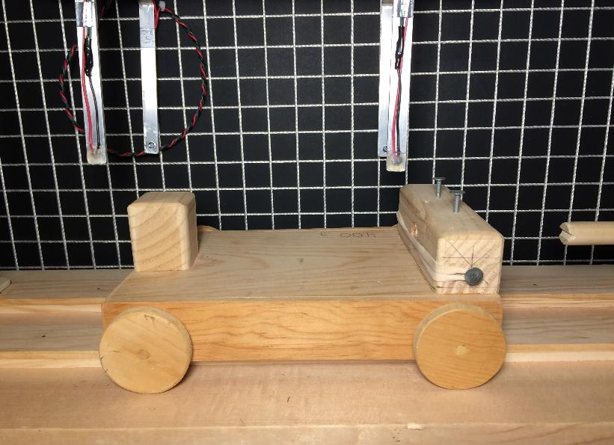
Friction 2
Rolling Objects
Classroom Lecture
LabRat Scientific
© 2018

Slide 2
Evidence that Friction Exists
When a wood block is slid across a table top, it eventually comes to rest.
According to Newton, since the motion of the block changes (i.e. it was decelerated) there must be some force acting opposite of the direction of motion (Newton’s 1st Law).

Slide 3
Evidence that Friction Exists
This adverse force is known as Friction. Friction always acts in a direction opposite the object’s motion (dynamic friction), but motion is not necessarily required for friction to exist (static friction)

Slide 4
Mechanism of Friction
No surface is perfectly smooth. There is always some roughness that will cause friction.
The friction is caused by surface adhesion, which is caused by the surface roughness
Points where Surface Adhesion is taking place
Motion of upper plate

Slide 5
Types of Friction
Static
This is the adhesion that exists before the object starts moving
It is the reason why it is a little harder to get a refrigerator to start moving across the floor when first pushed than it is to keep it moving.
Dynamic
This friction is less than static friction due to the fact that once the object gets moving, it tends to “skip” across the roughness

Slide 6
Rolling Friction vs. Sliding Friction
Sliding Friction
Rolling Friction

Slide 7
Rolling Friction
The friction force associated with a rolling object is generally less than that of a sliding object is because the microscope “welds” (a.k.a. adhesion) are “peeled” apart rather than “sheared” apart.
This concept may be better appreciated by a simple experiment using Velcro.

Slide 8
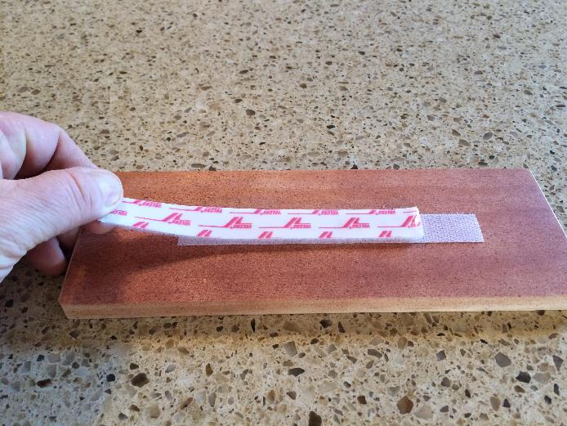
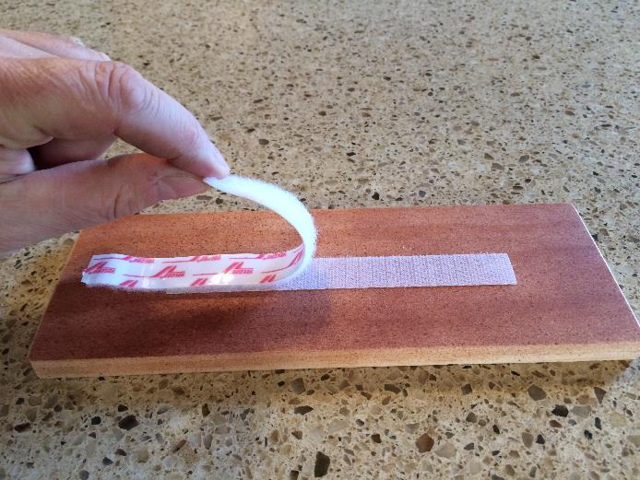
Separating Velcro by “shearing” takes a lot of force (analogous to sliding friction)…
Peeling the Velcro apart takes a lot less force (analogous to rolling friction)…

Slide 9
It’s this “peeling” feature is what makes wheels so much better than a sledge…
This lesson’s focus is on rolling friction.

Slide 10
Historical Tech-Fact
For a long time it was common knowledge (in the “olden days”) that a single horse could pull about 1 ton of cargo in a wagon riding on a smooth dirt road. Then, in the 1820 time frame, someone realized if you modified the wagon wheels a little and put them on iron rails, that same horse could pull 7 or 8 tons.
This was the birth of the railroads. Early on, there were no steam engines to pull the trains so they used horses. The railroad was essentially the first all-weather road system. The development of steam powered railroads revolutionized transportation forever, and was critical to building America…
Over time, harder and smoother steel replaced wood and iron, and rolling friction was reduced even more, making rail travel even more efficient.

Slide 11
Governing Equation
The equation governing friction is relatively simple and is as follows:
Friction Force = Coefficient of Friction * Normal Force
Friction Force = μ * N
Notice that the surface area of the objects DO NOT come into play (this seems a little counter-intuitive). This is due to the fact that the normal force is distributed over the contact area, and while there is more contact area for larger surfaces, the normal force is distributed over that larger area so the force per unit area is less at any given point.

Slide 12
Coefficient of Friction
The Coefficient of Friction (μ) is a unitless factor that describes how much frictional resistance a material or device has.
Systems can be complex, so often the Coefficient of Friction is determined experimentally. However, over the decades, engineers have developed a database of frictional characteristics for materials and devices. As a result, engineering estimates can be made during the design process. However, experiments are usually conducted to verify the estimates.

Slide 13
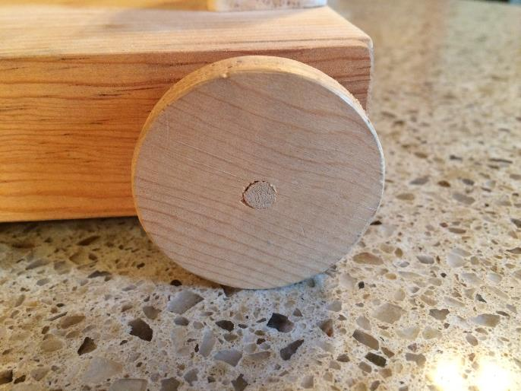
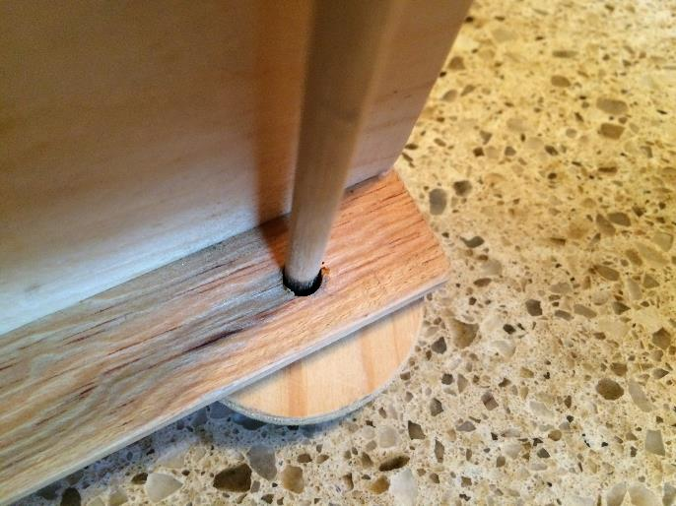
Friction Points on a Cart
There is friction between the wheel and the riding surface. As the wheel and surface get harder and smoother the friction goes down.
There is friction where the wheel axle interacts with the cart frame. Again, the harder and smoother the materials the lower the friction.

Slide 14
Static and Dynamic Friction – Rolling Object
Static and dynamic friction both exist for rolling objects. The equations governing both are generally the same except the coefficients of friction are different (usually much smaller than those for sliding objects). The equations are as follows :
Friction_{Static} = μ_{Static} * N
Friction_{Dynamic} = μ_{Static} * N
N
“N” is the normal force, which is the force exerted perpendicular to the traveling surface. For a horizontal surface, the normal force is equal to the weight of the cart.

Slide 15
The Normal Force
The normal force decreases as the traveling surface is inclined. In the extreme case when the angle is 90 deg, the normal force is zero and there will be no frictional force. In this case, the object would be in “free fall”.
ϴ
Force_{N} = Wt * Cos (ϴ)
Wt
ϴ
Force_{T} = Wt * Sin (ϴ)

Slide 16
Determining the Coefficient of Friction
A simple weight and pulley system can be used to determine the force needed to break the static friction or keep the cart rolling.
Weights are added to the cup until the cart begins to move. The force (weight) that causes the cart to finally move is the static friction.
N
N
μ_{Static} = ---------------
Friction_{Static}
Some basic algebra is applied to the friction equation to make it more directly applicable to the experimental data.
Dividing the weight of the cart by the force needed to get it moving gives the static coefficient of friction.

Slide 17
Determining the Coefficient of Friction
A similar experiment can be done to determine the dynamic coefficient of friction. As discussed earlier, the cart will slow down and stop due to dynamic friction (Newton says so…). If the frictional force can be exactly counteracted by another external force (i.e. tension in a string pulling on the cart) then the cart will continue to roll at a constant velocity (no acceleration or deceleration).
To determine the dynamic coefficient of friction, weights are added to the cup and then an impulse is applied to the cart. If the cart rolls momentarily then stops, additional weight is added. The test is repeated until the cart finally continues to move after the impulse is applied. This force (weight in the cup) is the dynamic friction. The friction equation can then be used to calculate the dynamic coefficient of friction.

Slide 18
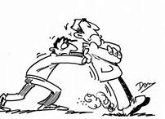
Questions?

